Slide 1



2017 ESVDC Young RESEARCH AWARD
Ariane Froidevaux, Ph.D.
Gainesville, September 23, 2017

Slide 2


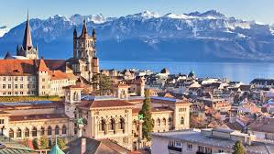
Personal career trajectory
University of Florida
Since 2016 Visiting Postdoctoral Researcher
Swiss National Science Foundation Fellow
University of Lausanne
2011-2016 Ph.D.
2006-2011 Career counselor Master degree
Who I am ?

Slide 3
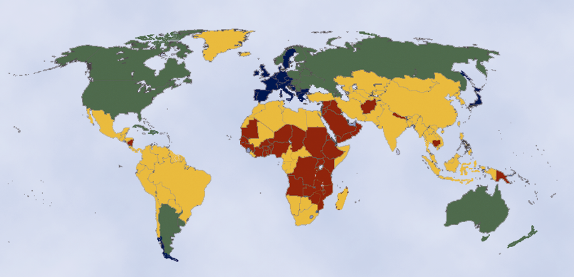
In 2000, A Fairly “Young” World…
Under 5%
5% to 12.4%
12.5% to 20%
Above 20%
Percent of Population Age 60+ in 2000

Slide 4
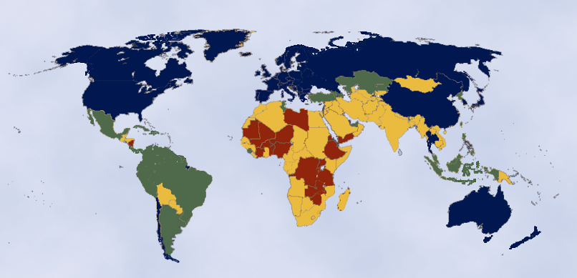
… Rapidly Aging by 2025
Under 5%
5% to 12.4%
12.5% to 20%
Above 20%
Percent of Population Age 60+ in 2025

Slide 5
Late careers
  Late careers represent a new career development stage that not only includes full retirement but also oscillates between employment, part-time work, volunteering, unemployment
Planning – 55+
Decision-making
Adjustment – 65+
Explore different issues of late careers & retirement
When to retire
How to retire
What to retire to
Getting used to changes
Achieve psychological comfort
Bridge employment
Career/ organization
Full-time to part-time
Employed to self-employed
  (Froidevaux & Hirschi, 2015)
RESEARCH OVERVIEW

Slide 6
Research overview
Planning & adjustment
Transition & adjustment
Antecedents and outcomes review (Froidevaux, Baumann, Maggiori, Wieber, & Rossier, 2017)
Experience of the process, outcomes, and resources (Froidevaux, Curchod, Degli-Antoni, Maggiori, & Rossier, in preparation; Froidevaux, 2016; Froidevaux & Hirschi, 2015)
Bridge employment
(Froidevaux, Alterman, Zhan, Shi, & Wang, in prep; Froidevaux & Hirschi, in prep)
Impact of Big-Five personality traits
Mechanism: attitudes toward retirement
Trajectories (Maggiori, Nihil, Froidevaux, & Rossier, 2014)
The role of mattering and social support at work (Froidevaux, Hirschi, & Wang, 2016)
Identity negotiation (Froidevaux, Hirschi, & Wang, under review; Froidevaux, in press; Froidevaux, Masdonati, Maggiori, & Rossier, in prep)
Career development
Hope (Hirschi, Abessolo, & Froidevaux, 2015)
Career adaptability (Stauffer, Maggiori, Froidevaux, and Rossier, 2014)
Self escape behaviors (Mohr, Haverly, Froidevaux, & Wang, in press)
Life design and lifespan theories (Hirschi & Froidevaux, under review; Nagy, Hirschi, Froidevaux, & Baumeler, in prep)
Economic stress and employment (Froidevaux, Koopmann, Wang, & Bamberger, in prep)
RESEARCH OVERVIEW
www.arianefroidevaux.wordpress.com

Slide 7

An overlooked challenge: Mattering
  the extent to which a person believes that she/he makes a difference in the world around her/him (Elliott, Kao, & Grant, 2004)
  the "problem of retirement is that others no longer depend upon [retirees]. The reward of retirement [may] be the punishment of not mattering” (Rosenberg and McCullough, 1981, p. 179)
RESEARCH OVERVIEW

Slide 8
Sample and procedure
Year 0
Year +1
Time 1
Older workers (N =371)
Retirees
(N =335)
Time 2
Older workers (N = 161)
Retirees
(N =178)
ORGANIZATIONS
ASSOCIATIONS
Self-reported online questionnaires, Switzerland
  (Froidevaux, Hirschi, & Wang, 2016, JVB)

Slide 9
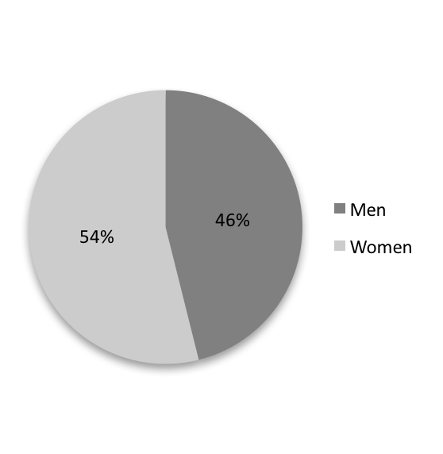
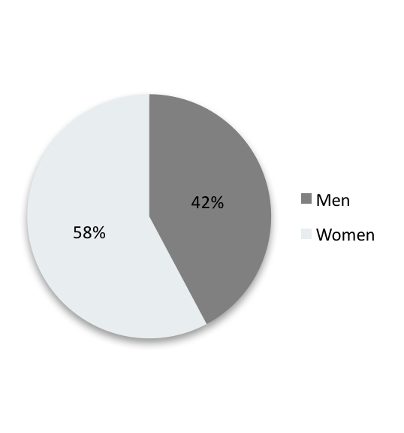
Sample and procedure (2)
Older workers (N=161)
Retirees (N=178)
Age: M = 58.55; SD = 2.6
Full time work: 61.5%
Age: M = 68.4; SD = 5.26
Official retirement age: 93.8%
  (Froidevaux, Hirschi, & Wang, 2016, JVB)

Slide 10
Study 1: Results for older workers
Latent mediation (SEM) model with bootstrapping approach:
  (Froidevaux, Hirschi, & Wang, 2016, JVB)

Slide 11
Study 2: Results for retirees
  (Froidevaux, Hirschi, & Wang, 2016, JVB)

Slide 12
Limitations
  Use of self-report & single source measures
  Embeddedness in specific time and place
  Use of non representative samples
    a focus on successful retirement adjustment among a privileged population
Notes:
For instance, happiness pursuit was reported to be more strongly endorsed by American than Chinese participants, while Chinese were more likely to endorse a dialectical balance between happiness and unhappiness than American participants ; we suggest that reconciling identity transition contradiction might be more difficult to achieve if a strong, positive value is placed on work in one's society or country
previous qualitative studies with a male sample reported important difficulties in adjusting to the changes in identity (Nuttman-Shwartz, 2004), while those focusing on a female sample reported a relatively easy retirement adjustment process (Price, 2000).

Slide 13
My future research directions
Planning & adjustment
Transition & adjustment
Antecedents and outcomes review (Froidevaux, Baumann, Maggiori, Wieber, & Rossier, 2017)
Experience of the process, outcomes, and resources (Froidevaux, Curchod, Degli-Antoni, Maggiori, & Rossier, in preparation; Froidevaux, 2016; Froidevaux & Hirschi, 2015)
Bridge employment
(Froidevaux, Alterman, Zhan, Shi, & Wang, in prep; Froidevaux & Hirschi, in prep)
Impact of Big-Five personality traits
Mechanism: attitudes toward retirement
Trajectories (Maggiori, Nihil, Froidevaux, & Rossier, 2014)
The role of mattering and social support at work (Froidevaux, Hirschi, & Wang, 2016)
Identity negotiation (Froidevaux, Hirschi, & Wang, under review; Froidevaux, in press; Froidevaux, Masdonati, Maggiori, & Rossier, in prep)
Career development
Hope (Hirschi, Abessolo, & Froidevaux, 2015)
Career adaptability (Stauffer, Maggiori, Froidevaux, and Rossier, 2014)
Self escape behaviors (Mohr, Haverly, Froidevaux, & Wang, in press)
Life design and lifespan theories (Hirschi & Froidevaux, under review; Nagy, Hirschi, Froidevaux, & Baumeler, in prep)
Economic stress and employment (Froidevaux, Koopmann, Wang, & Bamberger, in prep)
RESEARCH OVERVIEW
www.arianefroidevaux.wordpress.com

Slide 14

TO THE ESVDC AWARD COMMITTEE
FOR THIS GREAT HONOR …
&
FOR YOUR ATTENTION …
Contact - Ariane.Froidevaux@warrington.ufl.edu
www.arianefroidevaux.wordpress.com - Additional information

Slide 15
Publication list
Career development & counseling
Hirschi, A., Abessolo, M., & Froidevaux, A. (2015). Hope as a resource for career exploration: Examining incremental and cross-lagged effects. Journal of Vocational Behavior, 86, 38-47. doi: 10.1016/j.jvb.2014.10.006
Masdonati, J., Froidevaux, A., & Rossier, J. (2017). La recherche qualitative consensuelle en psychologie du conseil et de l’orientation [Consensual qualitative research in career counseling psychology]. In M. Santiago-Delefosse & M. del Rio Carral (Eds.), Les Méthodes Qualitatives en Psychologie et Sciences Humaines de la Santé [Qualitative Methods in Health Psychology and Human Sciences] (pp. 157-180). Paris: Dunod.
Stauffer, S. D., Maggiori, C., Froidevaux, A., & Rossier, J. (2014). Adaptability in action: Using personality, interest, and values data to help clients increase their emotional, social, and cognitive career meta-capacities. In M. Coetzee (Ed.), Psycho-Social Career Meta-Capacities: Dynamics of Contemporary Career Development (pp. 55-73). Dordrecht, The Netherlands: Springer.
Hirschi, A., & Froidevaux, A. (1st round of revisions). Career counselling. In H. Gunz, M. Lazarova, & W. Mayrhofer, Routledge Companion to Career Studies. Routledge.
Careers & OB
Froidevaux, A., Koopmann, J., & Wang, M. (in preparation; writing manuscript). The effect of objective and subjective economic stress on employment quality after graduation from college.
Mohr, C. D., Haverly, S. N., Froidevaux, A., & Wang, M. (in press). Escaping the self: Negative self-evaluations and employee alcohol misuse. In D. L. Ferris, R. E. Johnson, & C. Sedikides (Eds.), The Self at Work. Routledge, SIOP Organizational Frontiers Series.
Nagy, N., Hirschi, A., Froidevaux, A., & Baumeler, F. (in preparation; writing). Lifespan perspectives on careers and career development. In B. Baltes, C. Rudolph, & H. Zacher (Eds.), Work Across the Lifespan. Elsevier.
Retirement planning & adjustment
Froidevaux, A., Hirschi, A., & Wang, M. (2016). The role of mattering as an overlooked key challenge in retirement planning and adjustment. Journal of Vocational Behavior, 94, 57-69. doi: 10.1016/j.jvb.2016.02.016.
Froidevaux, A., Baumann, I., Maggiori, C., Wieber, F., & Rossier, J. (2017). Retirement planning: How to deal with different adjustment trajectories? In B.-J. Ertelt & M. Scharpf, Berufliche Beratung Älterer [Career Guidance for Older Workers] (pp. 25-53). Frankfurt-Am-Main, Germany: Peter Lang.
Froidevaux, A., & Hirschi, A. (2015). Managing the transition to retirement: From meaningful work to meaning in life at retirement. In A. De Vos & B. van der Heijden (Eds.), Handbook of Research on Sustainable Careers (pp. 350-363). Cheltenham, UK and Northampton, MA: Edward Elgar Publishing.
Maggiori, C., Nihil, R., Froidevaux, A., & Rossier, J. (2014). Development and validation of the transition to retirement questionnaire. Journal of Career Assessment, 22(3), 505-523. doi: 10.1177/1069072713498684.
Retirement decision-making
Alterman, V., Wang, M., Fasbender, U., & Froidevaux, A. Small business owners’ retirement decision-making: To sell or not to sell?
Retirement adjustment
Froidevaux, A. (2016). Favoriser l’adaptation à la retraite: Investigations qualitative et quantitative de l’identité, du sens et du sentiment de compter pour autrui [Adjusting successfully to retirement: Qualitative and quantitative investigations on identity, meaning and mattering]. L'Orientation Scolaire et Professionnelle, 45(3), 389-394. URL: http://osp.revues.org/5241.
Froidevaux, A. (in press). A life design perspective on the work to retirement transition. In V. Cohen-Scali, J. Rossier, & L. Nota (Eds.), International Perspectives on Current Research in Career Counseling and Guidance: Building Careers in Changing and Diverse Societies. Cham, Switzerland: Springer.
Froidevaux, A., Hirschi, A, & Wang, M. (1st round of revisions). Reconciling identity contradictions when transitioning from work to retirement: A theoretical model.
Froidevaux, A., Curchod, G., Degli-Antoni, S., Maggiori, C., & Rossier, J. (in preparation; writing manuscript). A retrospective consensual qualitative research on retirement adjustment resources, well-being, and identity.
Froidevaux, A., Masdonati, J., Maggiori, C., & Rossier, J. (in progress; data analysis). Exploring subjective identity forms in the transition from work to retirement: A consensual qualitative research analysis.
Bridge employment
Froidevaux, A., Alterman, V., Zhan, Y., Shi, J., & Wang, M. (in preparation; writing manuscript). The role of the Big-Five personality traits on bridge employment.
ARIANE FROIDEVAUX, PH.D.

